Slide 1
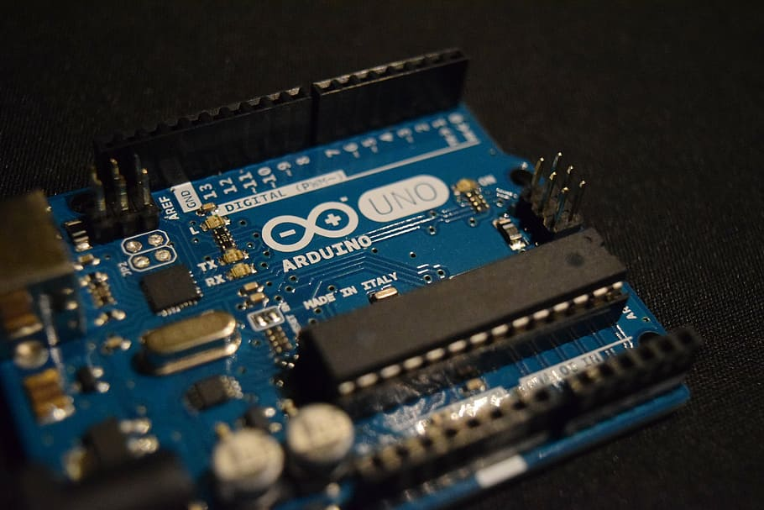
ARDUINO BASED ALCOHOL DETECTION WITH GSM & GPS

Slide 2
TEAM MEMBERS
NAME | ROLL_NO | PRN_NO
Tanisha Tambe | 204A064 | 72022701B
Tejas Gunjal | 204A065 | 72022709H
Aniket Totawar | 204A066 | 72022722E
Aditya Vaidya | 204A068 | 72022738M
Vinayak Bansode | 204A072 | 71905989F

Slide 3
TABLE OF CONTENTS
INTRODUCTION
ABSTRACT / LITERATURE REVIEW
COMPONENTS & SOFTWARE USED
CONTROL FLOW & CIRCUIT DESIGN
REFERENCES
CONCLUSION

Slide 4
INTRODUCTION
Drunk driving is one of the major reasons behind road accidents worldwide. In all of the road accident cases worldwide drivers have been observed to have excess alcohol content in their blood. So we here design a smart alcohol detector system
Using arduino coupled with gsm and gps for location transmission.
The system allows for automatic sensing of alcohol in breath, we also use a motor to demonstrate as a vehicle.
We further use a GPS module with GSM to send an SMS message to the concerned person in case alcohol is detected and stop the vehicle

Slide 5
LITERATURE REVIEW
Lee, Assessing the Feasibility of Vehicle-Based Sensors To Detect Alcohol Impairment. 2010, National Highway Traffic Safety Administration: Washington, DC
A. ISuge, H.Takigawa, H.Osuga, H.Soma, K.Morisaki, Accident Vehicle Automatic Detection System By Image Processing Technology , ©IEEE 1994 Vehiclee Navigation & information Systems Conference
Worrying about the drunken driving ,many existing system have worked on the problem but by using MQ2 gas sensor & PIC16F877A microcontroller.
Suggests the system to overcome the issue but using mQ2 alcohol sensor has come up with flames .MQ2 alcohol sensor is not authentic and raises the chance of false alarm while we have used MQ3 which is highly authentic
To prevent the mishap of drunken driving have used PIC16F877A microcontroller which is an out dated system and expensive one also which restrains its use to only certain class of society whereas we are using Arduino and Uno microcontroller which is advanced as well as economical.

Slide 6
COMPONENTS & SOFTWARE USED
HARDWARE SPECIFICATION:
C Capacitorsables and Connectors
Diodes
PCB
LED/ LDR
Push Buttons
Switch
Power supply
IC
IC Sockets
ARDUINO UNO
Buzzer
MQ3 alcohol sensor
LCD display
GPS module with antenna
GSM(SIM CARD) module
SOFTWARE SPECIFICATION:
Arduino IDE
EASYEDA PCB SCHMATIC

Slide 7
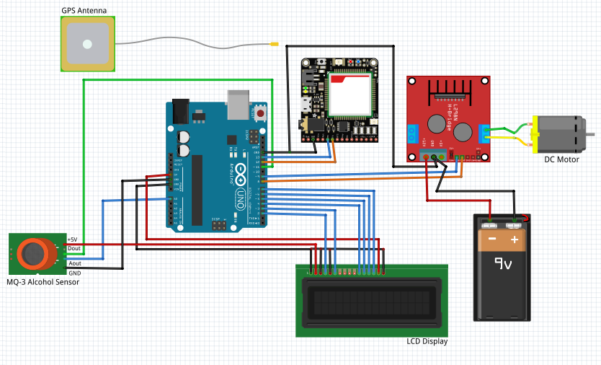
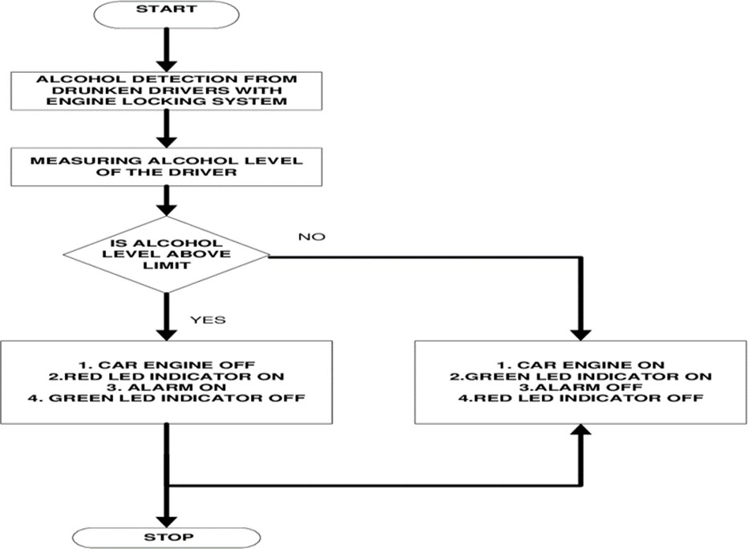
CONTROL FLOW & CIRCUIT DIGRAM

Slide 8
CONTROL FLOW & CIRCUIT DIAGRAM
CIRCUIT DESCRIPTION:
The system consists of an Arduino Uno board along with an Mq-3 alcohol sensor for detection and a GSM/GPS Module for notification.
In the case of a sober driver i.e. the alcohol is under the permissible limits the car will normally which is indicated by the motor rotating, but in the case of a drunk driver, the alcohol content would be higher than the permissible limit which is detected by the alcohol sensor and the Arduino controller which stops the motor so that drunk driving can be avoided and also sends an SMS notification to the authorities or family members along with the location of the car so that assistance can be provided.
The project also has an LCD for parameter display.

Slide 9
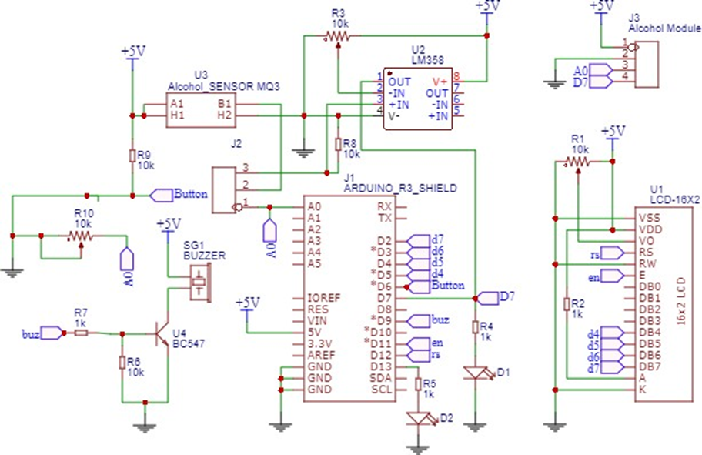
PCB SCHMATIC

Slide 10
ALCOHOL DETECTION LEVEL
HOW AN ALCOHOL SENSOR WORKS:
To get a blood alcohol content (BAC) reading, the users simply have to blow into a straw attached to the equipment for a few seconds. From here, the machine utilises the vapours in your breath to calculate an estimation of the level of alcohol in a person’s system. This simple approach is due to the fact that alcohol is not digested by the body and is merely absorbed through different parts. These include the mouth, stomach and intestines. As a result, traces of the material can still be identified minutes after drinking, making it possible for the Breath Analyser to calculate an accurate number.
Blood Alcohol Content (BAC) limits:
The concentration of alcohol in blood: 0.05 grammes per 100 millilitres (all drivers), professional drivers: 0.02 grammes per 100 millilitres.
Breath alcohol content: 0.24 milligrammes per 1000 millilitres (all drivers), professional drivers: 0.10 milligrammes per 1000 millilitres.

Slide 11
REFERENCE:
www.arduino.cc
https://easyeda.com/ADITYA06
Manila, Philippines-Design of Alcohol Detection System for Car Users thru Iris Recognition Pattern
Landu Jiang, Xi Chen, Wenbo He, “SafeCam: Analyzing intersectionrelated driver behaviors using multi-sensor smartphones”, PervasivComputing and Communications (PerCom), 2016 IEEE International Conference
Bill Montgomery, “IoT benefits beyond traffic and lighting energy optimization”, IEEE Consumer Electronics Magazine, Volume: 4, Issue: 4, Oct.2015

Slide 12
CONCLUSION
We have provided a very effective solution to develop an intelligent system for vehicles for alcohol detection whose core is Arduino. Since sensor has fine sensitivity range around 2 meters, it can suit to any vehicle and can easily be hidden from the suspects. The whole system has also an advantage of small volume and more reliability.
As the growing public perception is that vehicle safety is more important, advances in public safety is gaining acceptance than in the past. Future scope of this system is to control the accidents causes due to alcohol consumption. This system improves the safety of human being. And hence providing the effective development in the automobile industry regarding to reduce the accidents cause due to

Slide 13
THANK YOU
stay home & stay safe

